Slide 1


Language Translation using LSTM Algorithm
An overview of language translation using LSTM algorithm, including the AI model LSTM, analysis in Jupyter Notebook, and displaying the results in Tkinter GUI

Slide 2
Objective and Purpose
Introduce Objectives of language translation using LSTM algorithm
Explanation of the RNN and LSTM
Creating a model in Jupyter notebook and have a simple Translator App

Slide 3
Objective and Aim of the Project
The purpose of this project is to demonstrate how one can use AI/ML
In today’s globalized world language barriers are a big hinderance of communication between people different nationalities and regions. Therefore Machine Learning models and methods are utilized to break those said barriers.
It is very important to note that such Language Translation via Machine Learning is a well researched field of study.
Our goal is to demonstrate a simple translation GUI app and to use a sample dataset to train a LSTM model and investigate its accuracy.

Slide 4
LSTM and RNN
LSTM basic definition:
Long Short-Term Memory (LSTM) is a type of recurrent neural network (RNN) architecture designed to overcome the limitations of standard RNNs in capturing and retaining long-range dependencies in sequential data. LSTMs are particularly well-suited for tasks involving time series data, natural language processing, and other sequential data analysis.
RNNs and the Need for LSTMs:
Standard RNNs process sequential data by maintaining a hidden state that evolves as it receives new input elements in a sequence. However, they suffer from the "vanishing gradient" problem, which makes it challenging for them to learn long-term dependencies. This is because gradients that become too small during backpropagation prevent earlier time steps from effectively influencing later ones.
LSTM Introduction:
LSTMs were introduced to address this problem by introducing a more complex structure within the recurrent unit, which allows them to better capture and propagate information across long sequences.

Slide 5
Key Components and Operation of LSTM
a. Cell State (Ct): This is the central concept in LSTM. It represents the memory of the cell and can store information over long sequences. It is passed through the network with minimal alteration.
b. Hidden State (ht): This is similar to the hidden state in traditional RNNs and acts as a working memory of the LSTM cell.
c. Gates: LSTMs have three types of gates that control the flow of information in and out of the cell:
LSTM Operation:
The LSTM operations can be summarized as follows:
Forget gate operation:
ft = sigmoid(Wf * [ht-1, xt] + bf)
Input gate operation:
it = sigmoid(Wi * [ht-1, xt] + bi)
C_tilde = tanh(Wc * [ht-1, xt] + bc)
Update the cell state:
Ct = ft * Ct-1 + it * C_tilde
Output gate operation:
ot = sigmoid(Wo * [ht-1, xt] + bo)
Update the hidden state:
ht = ot * tanh(Ct)

Slide 6
Training LSTM -
LSTMs are trained using gradient-based optimization algorithms like backpropagation through time (BPTT) and variations of stochastic gradient descent (SGD). The vanishing gradient problem is mitigated through the gating mechanisms, which help LSTMs learn and retain long-range dependencies in data.Training Long Short-Term Memory (LSTM) models involves several steps. Here's a high-level overview of the process:
1. Data Collection and Preprocessing
2. Data Splitting
3. Model Architecture
4. Loss Function
6. Optimization Algorithm
7. Training
9. Inference
10. Decoding Strategies (Sequence-to-Sequence Tasks)
11. Evaluation
12. Hyperparameter Tuning

Slide 7
Furthermore…..
LSTMs are widely used in various natural language processing tasks, speech recognition, time series analysis, and many other sequential data applications due to their ability to capture complex patterns and long-term dependencies.
In summary, Long Short-Term Memory networks are a specialized type of recurrent neural network designed to address the vanishing gradient problem and effectively capture long-range dependencies in sequential data. Their architectural components, including cell state, hidden state, and gating mechanisms, make them powerful tools for modeling and understanding sequential data.
In the next section we will look at implementation of LSTM with BELU test in Jupyter Notebook

Slide 8
LSTM implementation in Jupyter Notebook
Introduction to the tools and libraries
Training and testing the LSTM Model
Using BELU algorithm to evaluate the output

Slide 9
Analysis in Jupyter Notebook
Project Jupyter is a project to develop open-source software, open standards, and services for interactive computing across multiple programming languages. It was spun off from IPython in 2014 by Fernando Pérez and Brian Granger.
In the context of this project we will be using Kaggle’s Jupyter Notebook to create and train a LSTM model.
This is to demonstrate the LSTM’s ability to perform translations form French to English.
Tools and Resources used -
Jupyter Notebook on Kaggle
French to English Dataset
Keras as the main library
Pandas for pre-processing
Natural Language Toolkit
Matplotlib for graphical representations

Slide 10
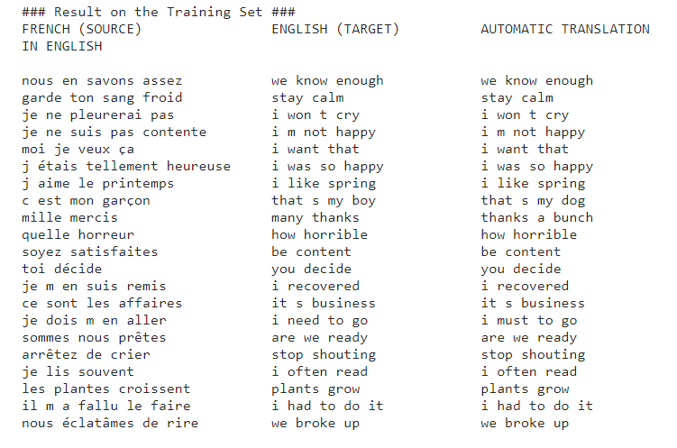
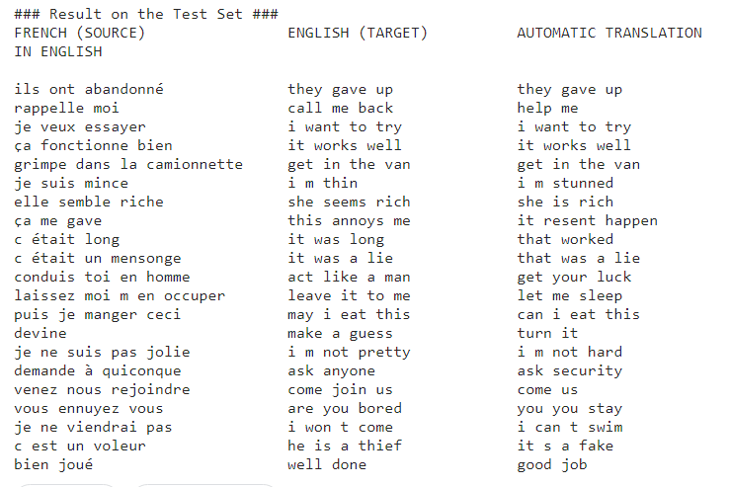
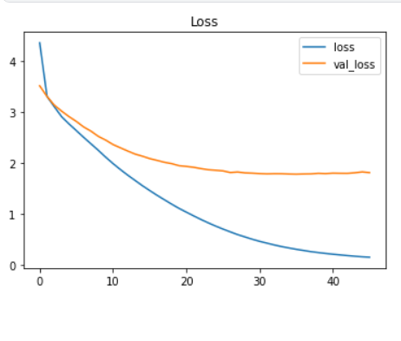
Result of Training
The result after the model is trained and the loss of the model.

Slide 11
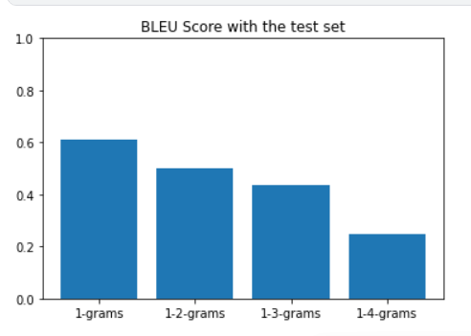
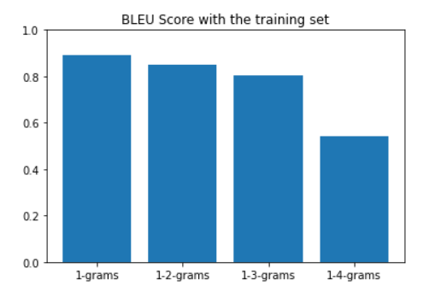
Methodology for training
Methodology to process, train and test the LSTM model is as follows –
Data Pre-processing – Here we use Pandas to perform pre-processing of the CSV file data i.e. the create the train and test sets for further use.
Create and train model – Here the Kera's and NLTK libraries for ML/AI are used to build and train the model. It includes models like LSTM, ‘corpus_belu’, Tokenizer, etc.
Result on test set – Towards the end a portion of the dataset will be used to test the model.
Prediction evaluation with BELU – Also BELU algorithm will be used to further investigate the accuracy of the LSTM model, here we use NLTK’s ‘corpus_belu’ method.
The result of the BELU score on training and test sets.

Slide 12
Tkinter Based Translator App
Introduction to Tkinter GUI Library
Utilizing PIP libraries to build and demonstrate a simple application for translation
Purpose of this app translation

Slide 13
Introduction to Tkinter and the Translator app
Tkinter is a Python binding to the Tk GUI toolkit. It is the standard Python interface to the Tk GUI toolkit, and is Python's de facto standard GUI. Tkinter is included with standard Linux, Microsoft Windows and macOS installs of Python.
The use of Tkinter is to demonstrate a simple GUI app for language translation.
Along with Tkinter we will also be using GoogleTrans, Textblob PIP libraries, there are other approaches to it.
This is to show a more practical implementation of the LSTM for language translation.

Slide 14
Steps involved to create the GUI
First, will be setting up an environment, one can use default environment on our device.
Secondly check the versions of python and PIP to make sure that we don’t end-up with older and deprecated language and tool features.
Then run the command ‘pip list’ to check whether Tkinter and other required libraries are present or not, if not simply use ‘pip install’ to install libraries.
After that, we created a git repository on local and on GitHub.io, where our codebase will reside.
After, that with command ‘code .’ to open VScode and started the development of the GUI app.
During development, we will be integrating different libraries like GoogleTrans, TextBlob with Tkinter ‘s application.
The UI has the following components –
The input text field.
Output text field.
Language selection box for both the languages.

Slide 15
Impacts of AI for Cross-Cultural Dialogues
The rise of artificial intelligence (AI) has revolutionized the field of language translation, making it faster, more accessible, and increasingly accurate. This has had a profound impact on various aspects of culture, breaking down communication barriers and fostering greater understanding between diverse communities around the world.
Here are some key ways AI is influencing the cultural landscape through language translation:
1. Breaking Down Language Barriers:
AI translation tools like Google Translate and DeepLearn are now capable of translating between hundreds of languages, enabling real-time communication across borders. This empowers individuals to connect with others from different cultures, fostering personal relationships and cultural exchange.
2. Accessibility to Information and Media:
AI translation opens doors to a wider range of information and media for people who may not speak the dominant languages in their region. This includes access to news, literature, educational materials, and entertainment, enriching cultural experiences and promoting global understanding.

Slide 16
3. Bridging Cultural Gaps:
By enabling people to understand each other's narratives and perspectives, AI translation tools can help bridge cultural gaps and build empathy. This can promote tolerance, combat prejudice, and foster intercultural dialogue.
4. Democratization of Knowledge and Culture:
AI translation removes language barriers to access knowledge and cultural expression, making them more accessible to individuals regardless of their linguistic background. This empowers people to participate in global conversations and contribute to a richer cultural exchange.
5. New Forms of Creative Expression:
AI translation tools are being used by artists and creators to explore new forms of expression by blending languages, translating art forms, and creating hybrid cultural experiences. This enriches the cultural landscape and promotes artistic innovation.
6. Ethical Considerations:
While AI translation offers immense benefits, it also raises ethical concerns. Bias within translation algorithms can perpetuate cultural stereotypes and discrimination. It's crucial to address these issues to ensure responsible and fair development of AI translation technology.

Slide 17
Conclusion
In conclusion, this presentation explored the application of the Long Short-Term Memory (LSTM) model and the BLEU (Bilingual Evaluation Understudy) score in achieving accurate and fluent language translation. We discussed the strengths of LSTMs in capturing long-range dependencies within sentences, allowing them to translate complex and nuanced language effectively. Additionally, we highlighted the BLEU score as a valuable metric to evaluate the quality of machine translations, providing insights into the model's accuracy and fluency.
Key findings:
LSTMs exhibited promising results in translating languages, achieving high BLEU scores and generating translations that closely resembled human-quality text.
The BLEU score proved to be a reliable metric for assessing the performance of the LSTM model, providing a quantifiable measure of translation quality.
Optimizations such as attention mechanisms and beam search further enhanced the model's performance, leading to even more accurate and natural-sounding translations.

Slide 18
Future directions:
Exploring the integration of LSTMs with other neural network architectures to further improve translation quality.
Utilizing advanced BLEU variants or alternative metrics to capture more nuanced aspects of translation quality, such as fluency and semantic similarity.
Investigating the application of LSTMs to translate less-resourced languages, addressing the challenges of limited training data and linguistic complexity.
Overall, the combination of LSTMs and the BLEU score presents a powerful approach to achieving high-quality machine translation. Further research and development in this field hold great promise for advancing the capabilities of automated language translation and bridging the communication gap between different cultures.
Additionally, consider mentioning the following points to strengthen your conclusion:
Address the limitations of the current approach, such as potential bias or sensitivity to domain-specific language.
Briefly discuss the potential societal impact of accurate and efficient machine translation.
Encourage further research and development in the field of neural machine translation.

Slide 19
Important Links and Resources
Kaggle Notebook – https://www.kaggle.com/code/adityabhambere/machine-translation-fr-en-with-bleu-score?scriptVersionId=154272184
GitHub Link –
Research Papers -
https://uu.diva-portal.org/smash/get/diva2:1540841/FULLTEXT01.pdf - 1st
https://www.ijraset.com/research-paper/language-translation-using-artificial-intelligence - 2nd
https://journals.plos.org/plosone/article?id=10.1371/journal.pone.0240663 - 3rd
https://www.researchgate.net/publication/347066090_The_use_of_machine_translation_algorithm_based_on_residual_and_LSTM_neural_network_in_translation_teaching - 4th
https://www.irjmets.com/uploadedfiles/paper/volume3/issue_6_june_2021/12649/1628083502.pdf-5th

Slide 20
Thank you for your time and attention 🙂

